Slide 1
Capstone Project
Health Insurance Cross Sell Prediction
Supervised Machine Learning
Individual Project:
Kedar Patil

Slide 2
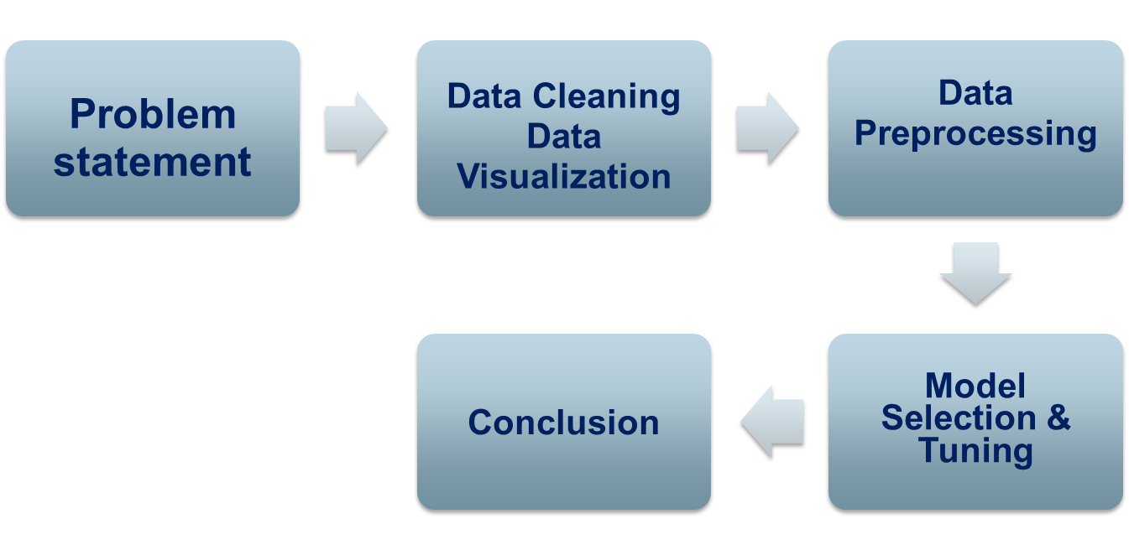
Contents

Slide 3


Problem Statement

Slide 4

What is an insurance policy ?
Insurance is a financial safety net, helping you and your loved ones recover after something bad happens — such as a fire, theft, lawsuit or car accident.

Slide 5
What is Cross-Sell Prediction?
In the financial services industry, cross-selling is a popular term.
Cross-selling involves selling complementary products to existing customers. It is one of the highly effective techniques in the marketing industry.

Slide 6
Data Summary
●id :- Unique ID for the customer
●Gender :- customers gender
●Age :- Age of the customer
●Driving_License :- Customer is having driving license or not
●Region_Code :- Unique code for the region
●Previously_Insured :- Whether the customer has insured previously or not
●Vehicle_Age :- Age of the Vehicle
●Vehicle_Damage :- Is the customer got his/her vehicle damaged in the past
●Annual_Premium :- The amount customer needs to pay as premium in the year
●PolicySalesChannel :- Anonymized Code for the channel of outreaching to the customer ie. Different Agents, Over Mail, Over Phone, In Person, etc.
●Vintage :- Number of Days, Customer has been associated with the company
●Response :- The customer is interested or not

Slide 7
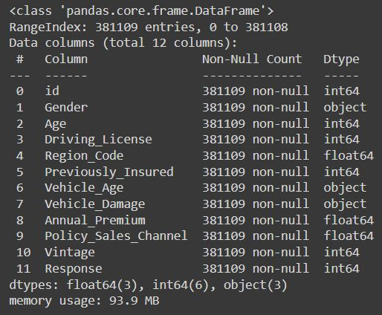
Data Exploration
The dataset consists of three objective columns and eight numeric columns.
shape of dataset
rows:-381109,column:-12
Dataset don’t have any null value and duplicates.

Slide 8
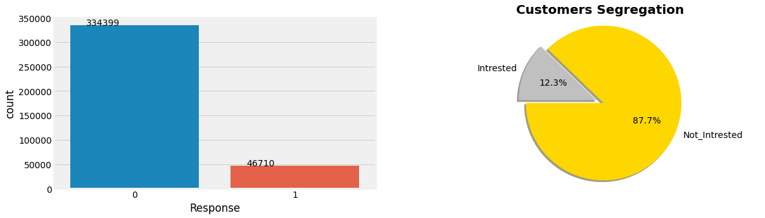
Dependent variable
The given dataset is an imbalance problem as the Response variable with the value 1 is significantly lower than the value zero.
The people not interested is 87 % as compared to the interested once.

Slide 9
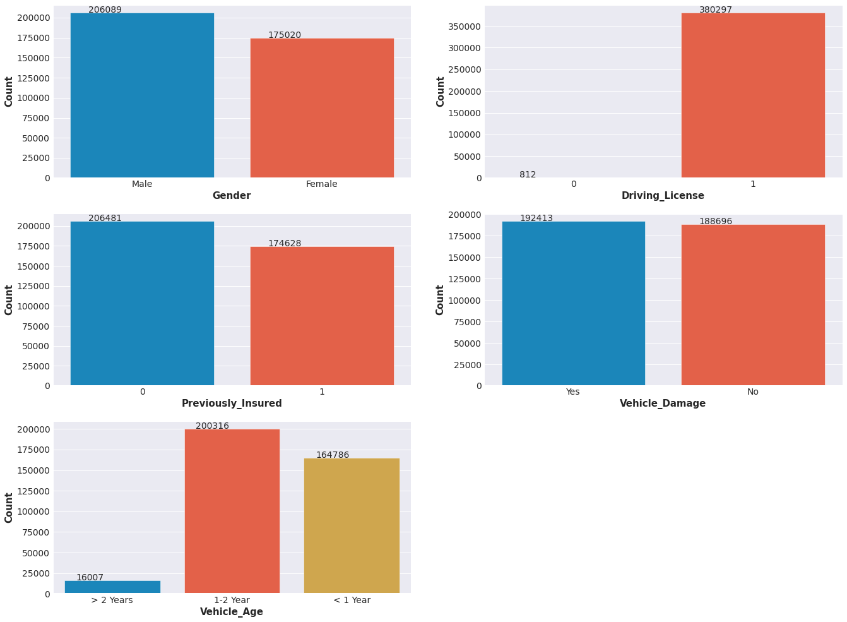
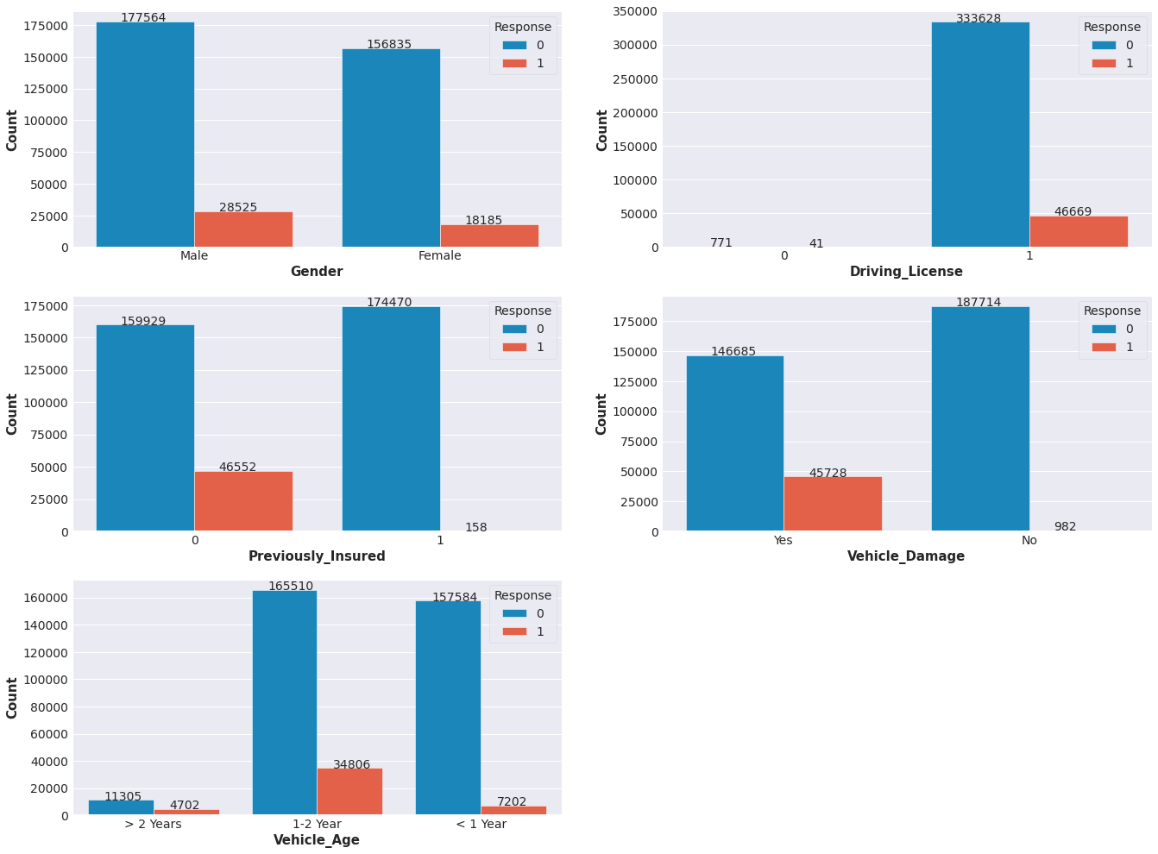
Gender
From the graph the gender variable ratio in the dataset is almost equal, male category is slightly more than female and also the chances of buying insurance is also little high than female.
From 2nd graph we can say that , The number of male is interested which is greater than 25000 and The number of female is interested which is below 25000.

Slide 10
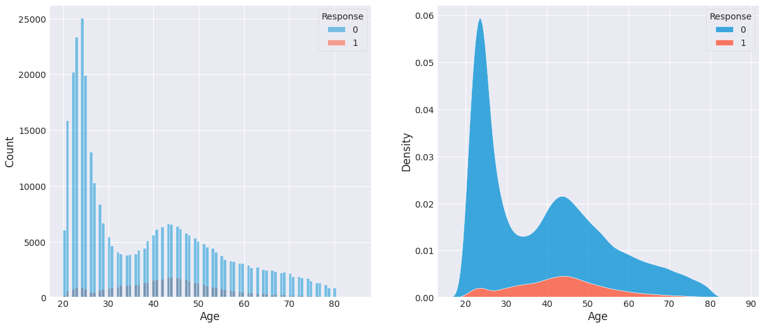
Age countplot
Young people below 30 are not interested in vehicle insurance. Reasons could be lack of experience, less maturity level and they don't have expensive vehicles yet.
People aged between 30-60 are more likely to be interested.

Slide 11
Data Visualization
The vehicle age is in between 1 to 2 year they are taking more insurance than others.
Those who have not insurance some of them are taking insurance.

Slide 12
Data Visualization
From the plot, we can conclude that if the vehicle has been damaged previously then the customer will be more interested in buying the insurance as they know the cost.
The customers who have driving licences will option for insurance instead of those who don’t have it.

Slide 13
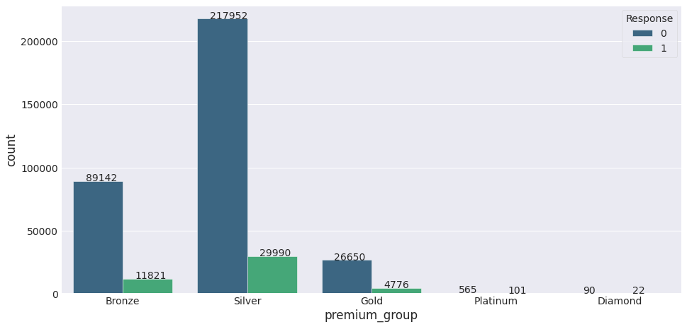
Premium Group
The more expensive the premium group the more likely the customer are interested with the vehicle insurance.

Slide 14
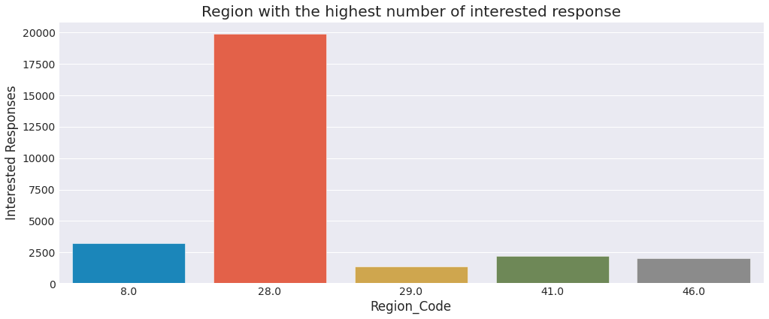
Top five Regisons
In region 28 the people are highly intersted in buying insurance than other region.

Slide 15
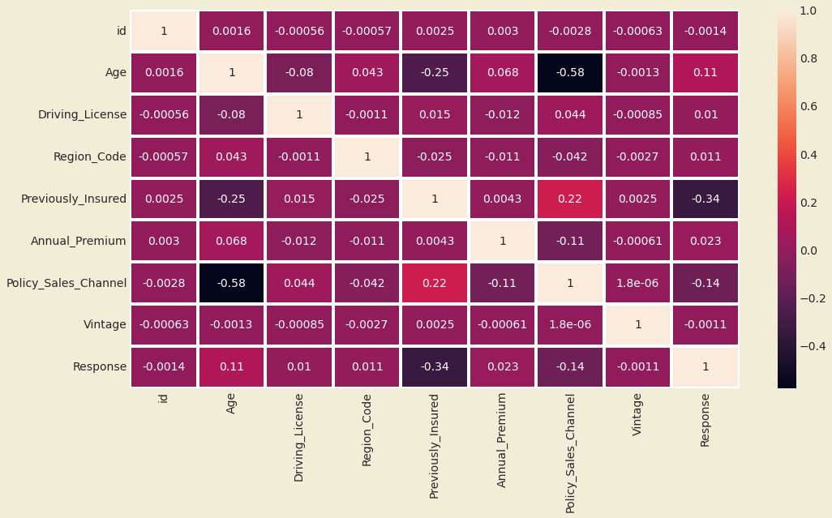
Correlation Matrix
policy sales channel and vintage are more negatively correlated to the target variable response

Slide 16
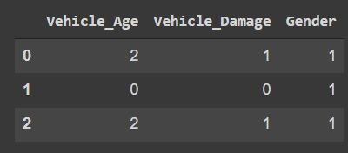
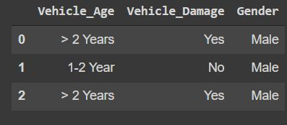
Data preprocessing
Similarly Using OneHotEncoder we done encoding on 'premium_group' column.

Slide 17
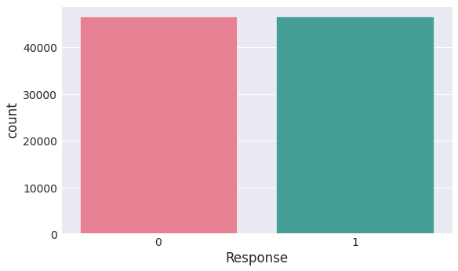
Handling imbalance data
Using RandomOverSampler to resample because as you can
see the data is highly imbalanced

Slide 18
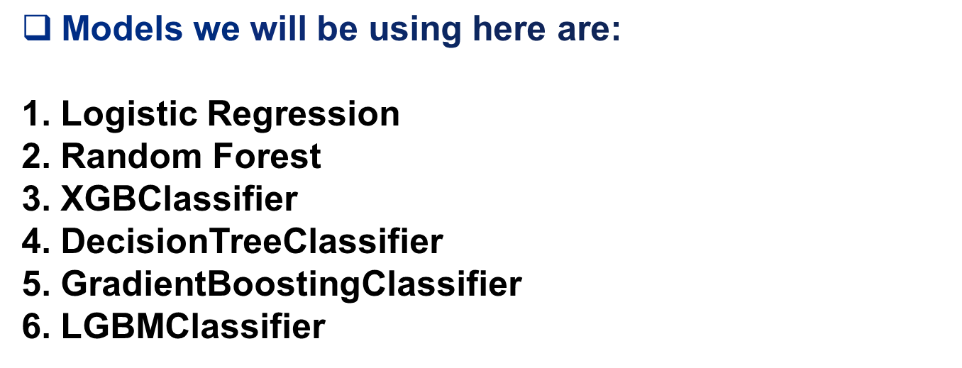
Model Selection
This problem can be identified as Binary Classification (wheather customer opts for vehicle insurance or not)

Slide 19
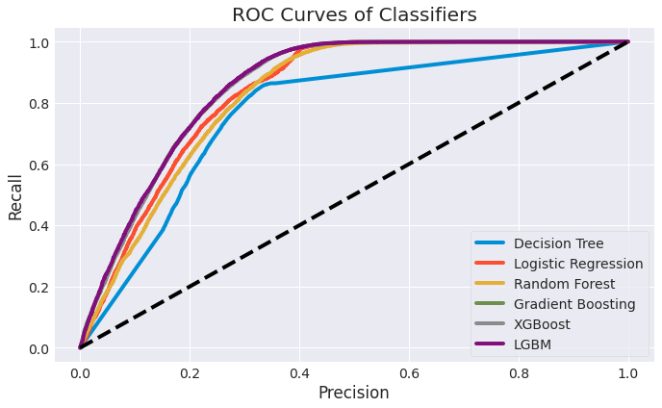
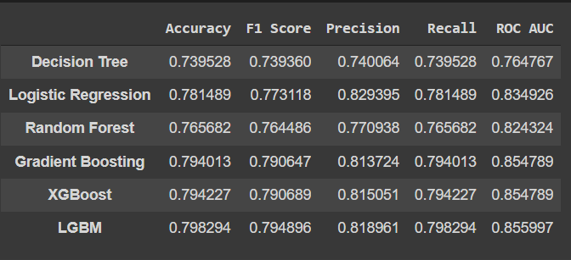
Baseline model
We select LGBM and XGBoost as final model.

Slide 20
Hyperparameter Tuning
● Best hyperparameters values for LGBM and XGBoost
● Used RandomizedCV
LGBM best parameter
'colsample_bytree': 0.5172548939279122,
'min_child_samples': 360,
'min_child_weight': 1,
'num_leaves': 41,
'reg_alpha': 50,
'reg_lambda': 10,
'subsample': 0.8334396010955798
XGBoost best Prameter
'n_estimators': 180, 'max_depth': 4, 'learning_rate': 0.1

Slide 21
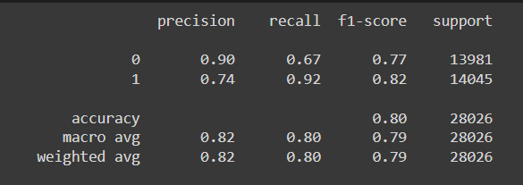
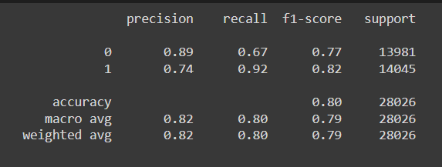
Best model
LGBM and XGBoost give same result
XGBoost
LGBM

Slide 22
Conclusion
The given dataset is an imbalance problem as the Response variable with the value 1 is significantly lower than the value zero.
The people not interested is 87 % as compared to the interested once.
The male customers own slightly more vehicles and they are more tend to buy insurance in comparison to their female counterparts.
The customers who have driving licences will option for insurance instead of those who don’t have it.
we can conclude that if the vehicle has been damaged previously then the customer will be more interested in buying the insurance as they know the cost.
the customers with vehicle age lesser than the 2 years are more tend to buy insurance.
People aged between 30-60 are more likely to be interested.
Young people below 30 are not interested in vehicle insurance. Reasons could be lack of experience, less maturity level and they don't have expensive vehicles yet.

Slide 23
Conclusion
Region 28 the people are highly intersted in buying insurance than other region.
Out of six models LGBM ,Gradient Boosting and XGBoost gives good results in terms if recall and ROC AUC.For hyperparamter tuning i choose LGBM and XGBoost.
Using the LGBMClassifier and XGBoostClassifier that has recall of 80% will speed up and find out which customer who actually intersted in vehicle insurance, and we could focus our resource just based on the customers that's interested.
We found out that customer who already have vehicle insurance are almost have no interest in another vehicle insurance. Our analysis shows that 99.9% of customers that have a vehicle insurance is not interested in another vehicle insurance, while customer who doesn't have a vehicle insurance 22.5 % of them are interested with vehicle insurance.
Lower annual prices are more likely to encourage customers to renew and vice versa.

Slide 24


